Slide 1
FOX OF HOOD PROJECT STATUS REPORT | FINAL
Team B
Manila Aryal, Grace Frizzell, Tamsyn Evezard, Ngoc Bui, Berkan Guven
12/03/2024 6:00pm
https://github.com/ettany/FOH_PSE.git
Notes:
Manila

Slide 2
Roles
Grace: Database & Transaction Lead
Manila: Activity Log, UI, User Portfolio Lead
Ngoc: Visualization & CAPTCHA Lead
Tamsyn: Authentication & API Lead
Berkan: Facial Recognition Lead
Notes:
Manila

Slide 3
Project Info
How our team operates:
Zoom
WhatsApp & Email
In-Person Meetings
Development process used:
Agile/incremental
Tools used:
Planning: Asana
Development: VS Code, FIGMA (UI visualization), shared GitHub repository
Notes:
Berkan

Slide 4
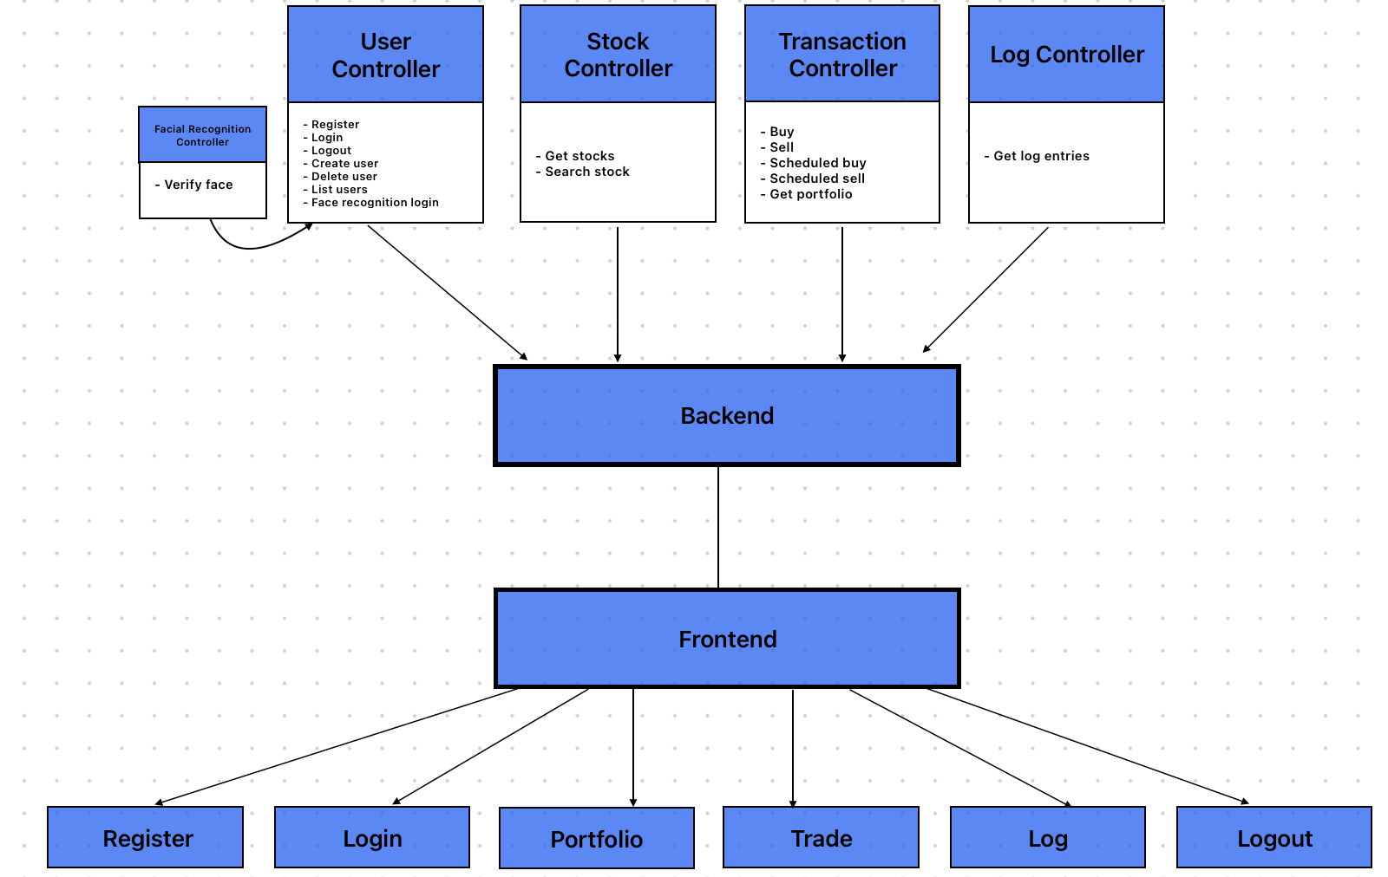
Software Architecture of Fox of Hood
Notes:
Manila

Slide 5
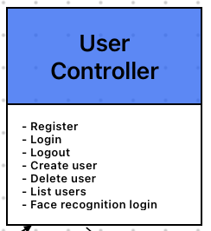
Software Architecture | Traceability
Example: "Administrators should be able to manage user accounts"
SRS: Administration | REQ-2: Allow admin account to create new user accounts
Account-based privileges
Separate dashboard for "administration" account
Used in admin page
Notes:
Tam

Slide 6
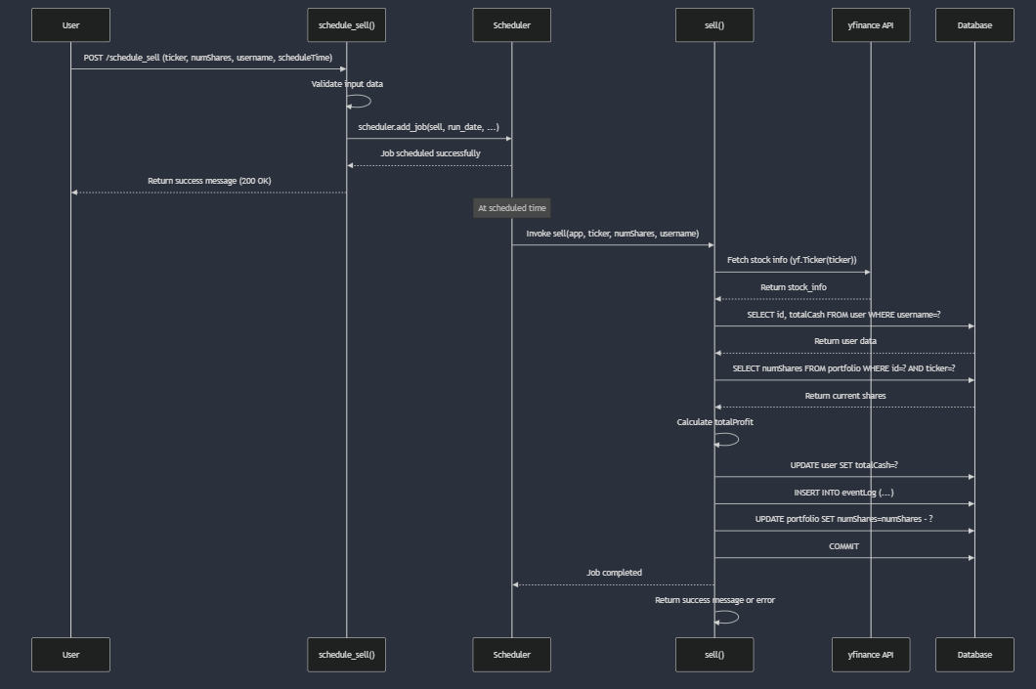
Developed Software | Buy & Sell Stocks
Notes:
Grace

Slide 7
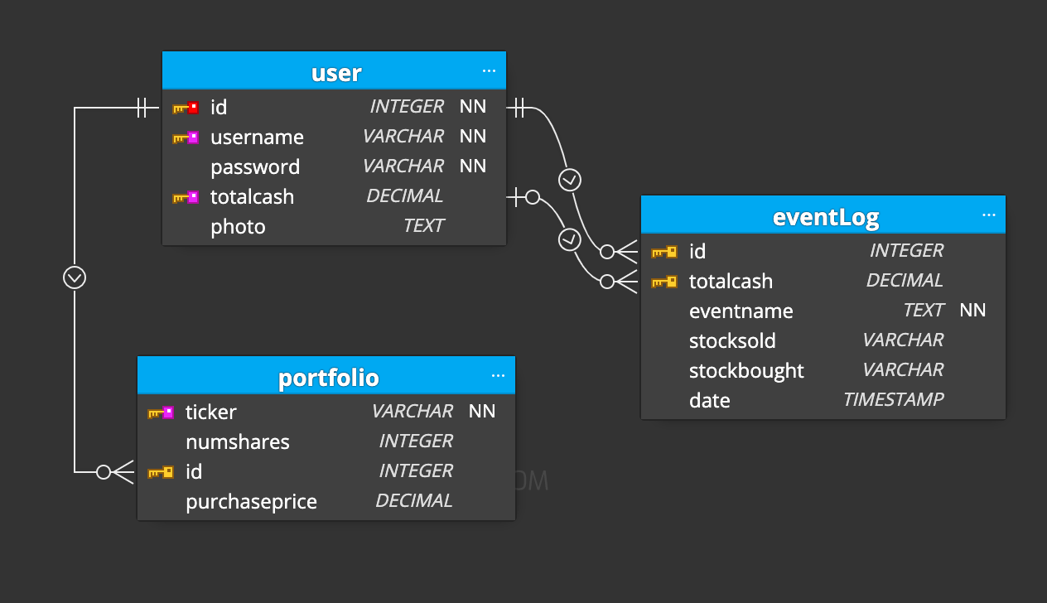
Developed Software | Database
Notes:
Grace

Slide 8
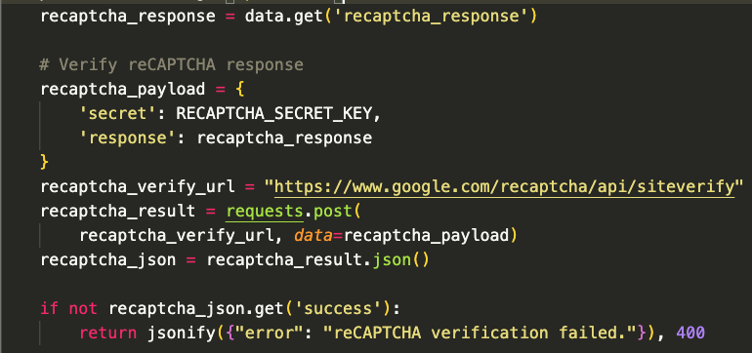
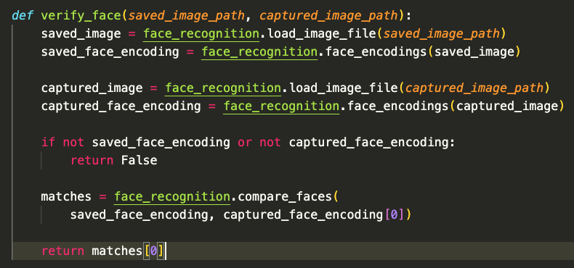
Developed Software | Security
CAPTCHA
Facial Recognition
Other simple security measures:
Password hashing with werkzeug
2. Identical username prevention
3. Password requirements (length, numbers, special characters)
4. Account-based access control (user vs admin)
Notes:
Ngoc and Berkan

Slide 9
Accomplished Work
Register & Login: username, password, facial recognition, CAPTCHA
Database: user, portfolio, and eventLog tables
Portfolio
Balance
Stock portfolio
Graph: profit
Trade
Search
Buy, sell, schedule
Graphs: searched stock, top 5 stocks
Log
Log on, logg off, buy, sell
Notes:
Berkan

Slide 10
Accomplished Work
How good is it?
Reached milestones & requirements before due date
Structured plan
Designated leaders
Project size:
Estimated 400 - 450 hrs total
+- 8-9 hrs pp/week over 10 weeks
Developing the product to ensure compatibility:
Python & Flask (backend)
SQL (database schema)
Frontend (HTML, CSS, JavaScript)
API: yahoo finance
Notes:
Berkan

Slide 11
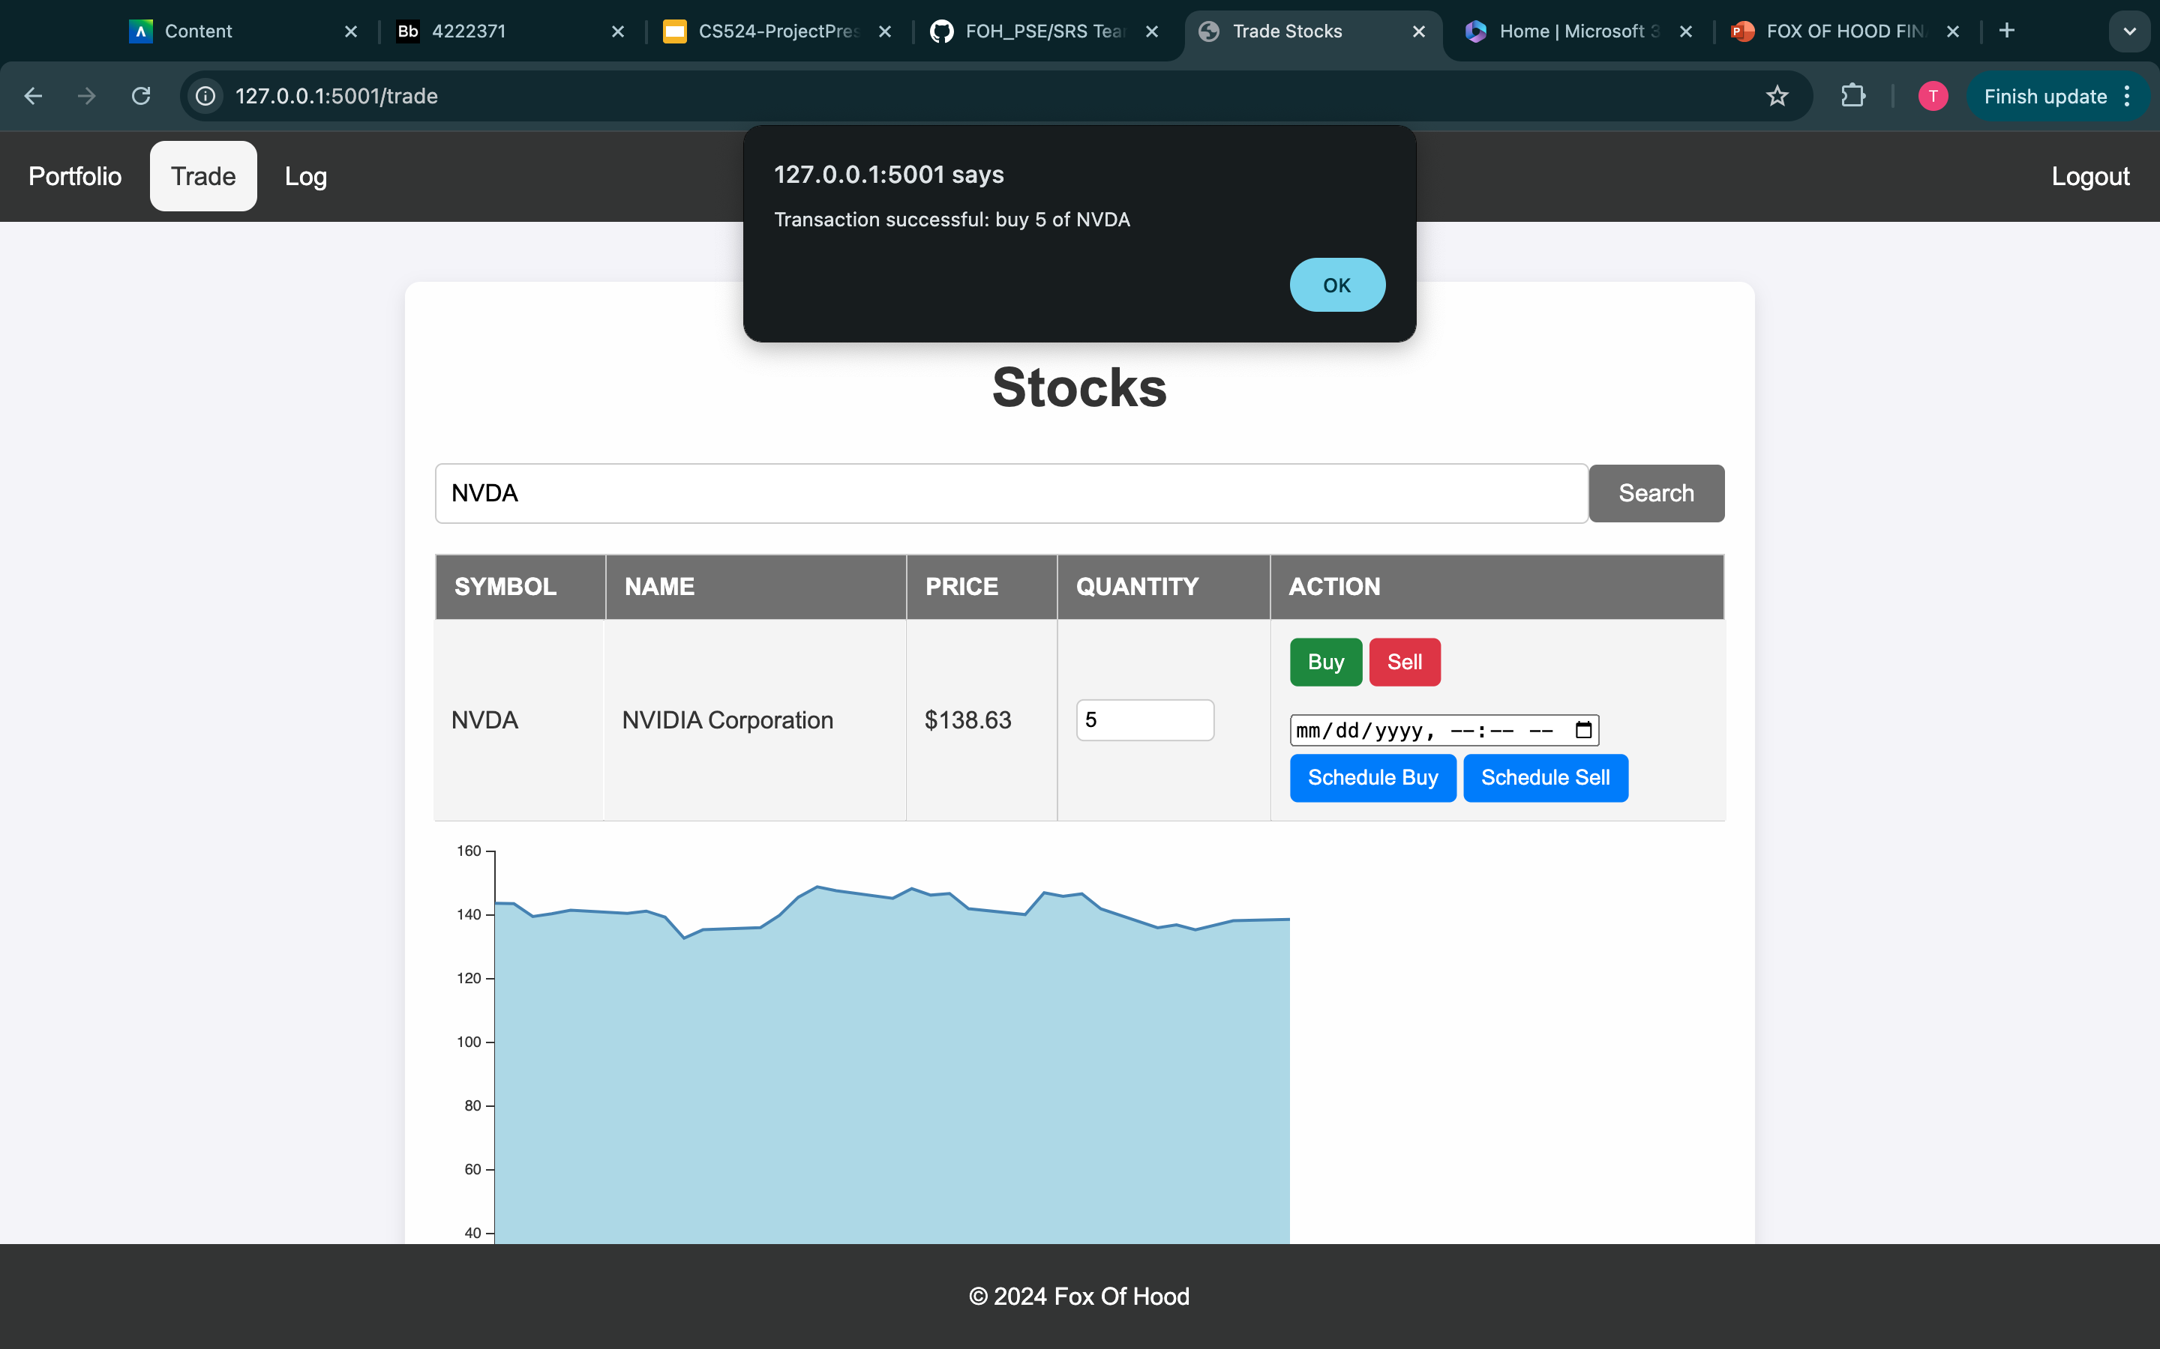
Notes:
Ngoc - don’t spend too much time on this since we are doing a demo: just mention how it shows the price for NVDA for last 30 days in graph, successful buying of 5 shares of NVDA, and the schedule transaction functionality.

Slide 12
Lessons Learned
Success
Focus on priorities
Established leadership roles
Manageable chunks
Ownership
Collaboration
Struggles
Initially:
Collaboration
Buy and sell functionality
Maintaining session
Lessons
Establish roles and rules earlier in the SDLC
Stick to familiar languages and frameworks
Notes:
Tamsyn

Slide 13
Demo
https://youtu.be/7XaVBbRt8u4
Notes:
Tamsyn

